Slide 1

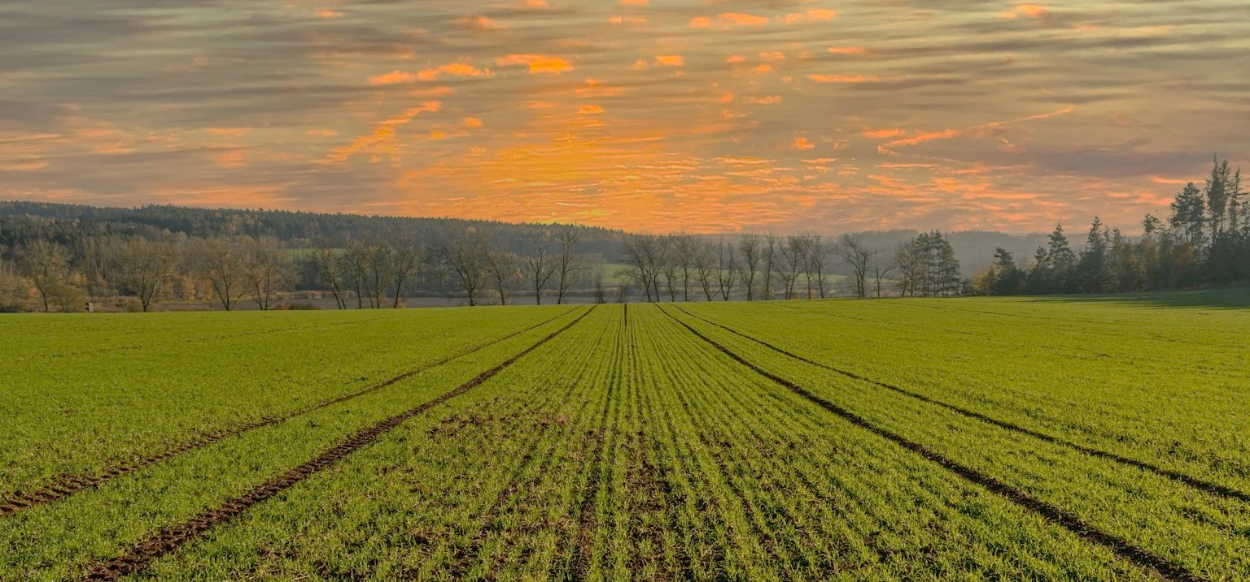

ABSTRACT
ABSTRACT
HALDIA INSTITUTE OF
TEC
HNOLOGY
DEPARTMENT OF COMPUTER SCIENCE ENGINEERING
PROJECT PRESENTATION ON
NE LEARNING
CROP YIELD PREDICTION USING MACHI
Under the Guidance of
Dr. ARINDAM GIRI
ASSOCIATE PROFESSOR, DEPARTMENT OF CSE
Presented By:
SAGARIKA PRADHAN
21/CSE/129
SHREYA CHAKRABORTY
21/CSE/151
SUDHANSHU RAJ
21/CSE/170
SWARNADEEP SAHANI
21/CSE/182
Predict Crop Yield
Utilize Data
ML Models
Improve Productivity

Slide 2
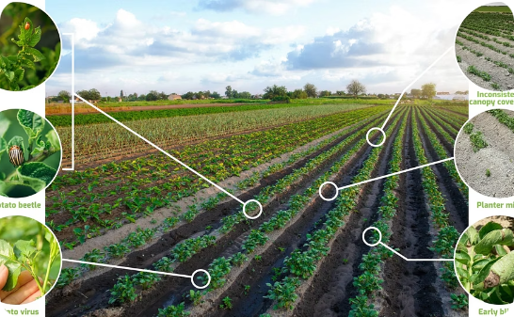
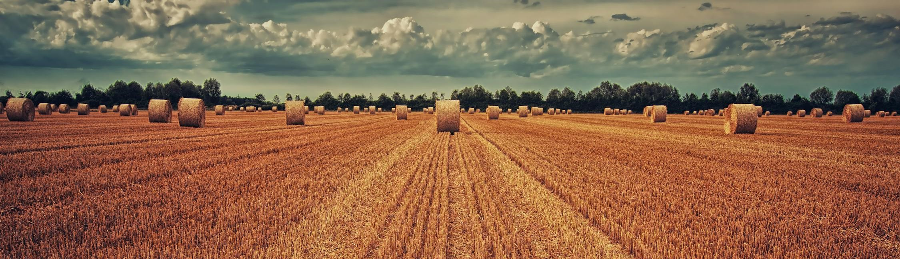
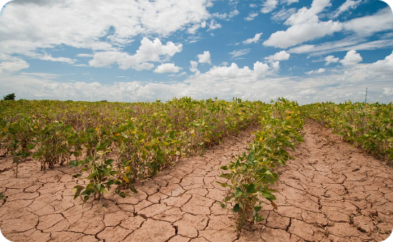
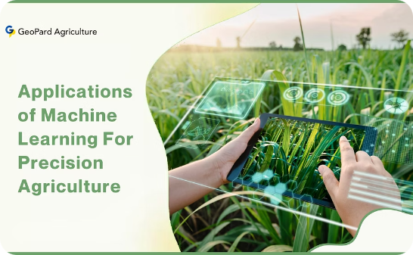
Importance
Accurate crop yield prediction is vital for successful farming.
Introduction
ABSTRACT
Introduction
Introduction
Predict Crop Yield
Utilize Data
ML Models
Improve Productivity
ABSTRACT
Project Requirment
Challenges
Climate variability, soil degradation, and manual errors hinder prediction reliability.
Design
Implementation
overview
PART 06
PART 07
ML Solution
Machine learning offers automated and precise yield forecast solutions.

Slide 3
Existing Methods
Traditional vs. ML approaches.
ML in agriculture case studies.
PART 01
Introduction
Importance
Accurate crop yield prediction is vital for successful farming.
Project Requirment
Challenges
Introduction
Design
Climate variability, soil degradation, and manual errors hinder prediction reliability.
Implementation
overview
ML Solution
Van Klompenburg et al. (2020): ANNs best for complex data.
Kalaiarasi et al. (2021): Used ensemble methods + web tool.
Agarwal et al. (2021): SVM + mobile app with sensor data.
Machine learning offers automated and precise yield forecast solutions.
PART 06
PART 06
Gaps Identified
Lack of real-time data.
Need for region-specific models.

Slide 4
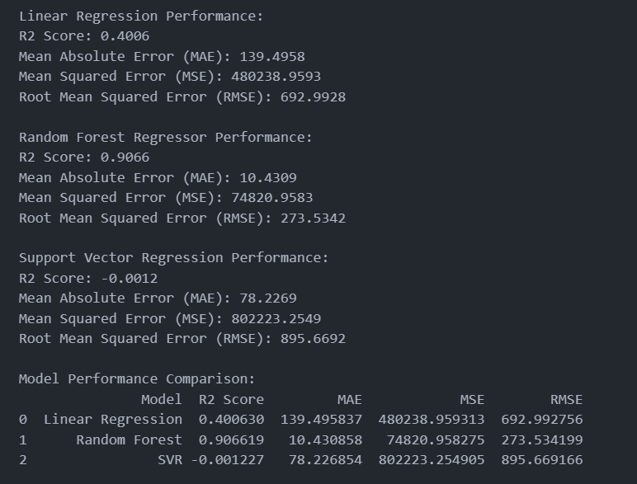



PART 01
Literature review
Van Klompenburg et al. (2020): ANNs best for complex data.
Kalaiarasi et al. (2021): Used ensemble methods + web tool.
Agarwal et al. (2021): SVM + mobile app with sensor data.
Introduction
PART 06
Linear Regression
Simple, foundational model.
Random Forest
High accuracy, heterogeneous data.
Support Vector Machine
Complex pattern recognition.

Slide 5

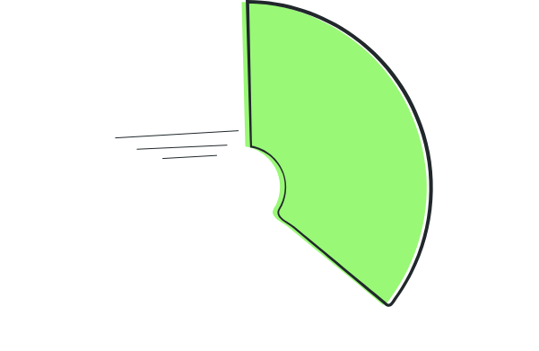




Software
Python, Pandas,
Scikit-learn,
React,Flask
PART 01
Technical
survey
Fig 1 : Dataset overview
Introduction
Fig 2 : Performance of model
PART 06
Data Sources
Gov datasets, Kaggle
Hardware
8GB RAM, i5 Processor.

Slide 6
PART 01
Project requirment
Data Sources
Gov datasets, Kaggle
Software
Python, Pandas,
Scikit-learn,
React,Flask
System requirment
Introduction
Hardware
8GB RAM, i5 Processor.
PART 06
1
SRS
Data preprocessing, model training, prediction.
2
Non-functional
Scalability, user-friendly interface.
3
Use Case
Farmers, agronomists as users.
4
Algorithm
Random Forest workflow, ensemble learning.

Slide 7
Preprocessing
PART 01
Data Collection
PART 02
Project requirment
Design
1
SRS
Design
Data preprocessing, model training, prediction.
2
Non-functional
Project requirment
Implementation
overview
Scalability, user-friendly interface.
3
Use Case
Farmers, agronomists as users.
Future Scope
4
Algorithm
Random Forest workflow, ensemble learning.
Conclusion
Model Training
Reference
Prediction

Slide 8
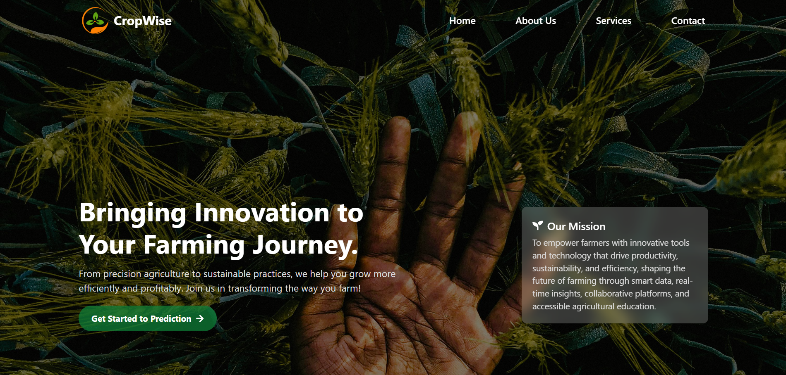
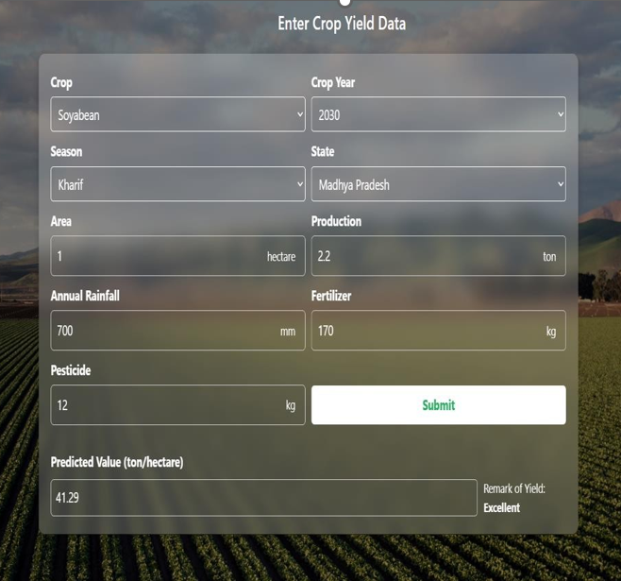
PART 02
PART 03
Implementation
overview
PART 01
Design
Implementation
overview
Data Collection
Preprocessing
Future Scope
Design
Model Training
Conclusion
Prediction

Slide 9





Real-time Decision Making
IoT + Sensors
User friendly interface
Climate Change Adaptation
Disaster Management & Risk Mitigation
PART 03
PART 04
Implementation overview
Implementation
overview
PART 02
Future Scope
Future Scope
PART 01
Conclusion
Implementation
overview
Fig.4. Soyabean Prediction
Fig.3. user-interface

Slide 10
PART 04
PART 05
PART 03
Conclusion
Future Scope
PART 02
Conclusion
Real-time Decision Making
IoT + Sensors
PART 01
User friendly interface
Future Scope
Climate Change Adaptation
Disaster Management & Risk Mitigation
Machine learning improves agricultural yield prediction.
Enhance productivity and helps in optimizing resources by providing accurate predictions.
Future integration of real-time data and IoT can further transform farming decisions

Slide 11
PART 05
PART 06
PART 04
Conclusion
van Klompenburg, T., Kassahun, A., & Catal, C. (2020). Crop yield prediction using machine learning: A systematic literature review. Computers and Electronics in Agriculture, 177, 105709. https://doi.org/10.1016/j.compag.2020.105709
Agarwal, S., & Tarar, S. (2021). A hybrid approach for crop yield prediction using machine learning and deep learning algorithms. Journal of Physics: Conference Series, 1714(1), 012012. https://doi.org/10.1088/1742-6596/1714/1/012012
https://www.kaggle.com/datasets/akshatgupta7/crop-yield-in-indian-states-dataset
Images used are sourced from Pexels, licensed stock image platforms, and AI-generated tools
Machine learning improves agricultural yield prediction.
Enhance productivity and helps in optimizing resources by providing accurate predictions.
Future integration of real-time data and IoT can further transform farming decisions.
PART 03
PART 02
Conclusion
PART 01

Slide 12


PART 05
PART 06
PART 07
PART 04
van Klompenburg, T., Kassahun, A., & Catal, C. (2020). Crop yield prediction using machine learning: A systematic literature review. Computers and Electronics in Agriculture, 177, 105709. https://doi.org/10.1016/j.compag.2020.105709
Agarwal, S., & Tarar, S. (2021). A hybrid approach for crop yield prediction using machine learning and deep learning algorithms. Journal of Physics: Conference Series, 1714(1), 012012. https://doi.org/10.1088/1742-6596/1714/1/012012
https://www.kaggle.com/datasets/akshatgupta7/crop-yield-in-indian-states-dataset
Images used are sourced from Pexels, licensed stock image platforms, and AI-generated tools
PART 03
PART 02
References
PART 01

Slide 13
PART 05
PART 06
PART 07
PART 04
PART 03
PART 02
Any Question
PART 01

